Slide 1

Course Code:
Course Title: Accounting & Finance
Class Day: Friday
Lecture / Week No. 15 (Risk and Rates of Return)
(05/01/2024)
Instructor Name: Asim Iqbal
Management Sciences Department
Bahria University, Karachi Campus

Slide 2
Lecture # 8 Risk and Rates of Return
Stand-alone risk
Portfolio risk
Risk & return: CAPM / SML

Slide 3
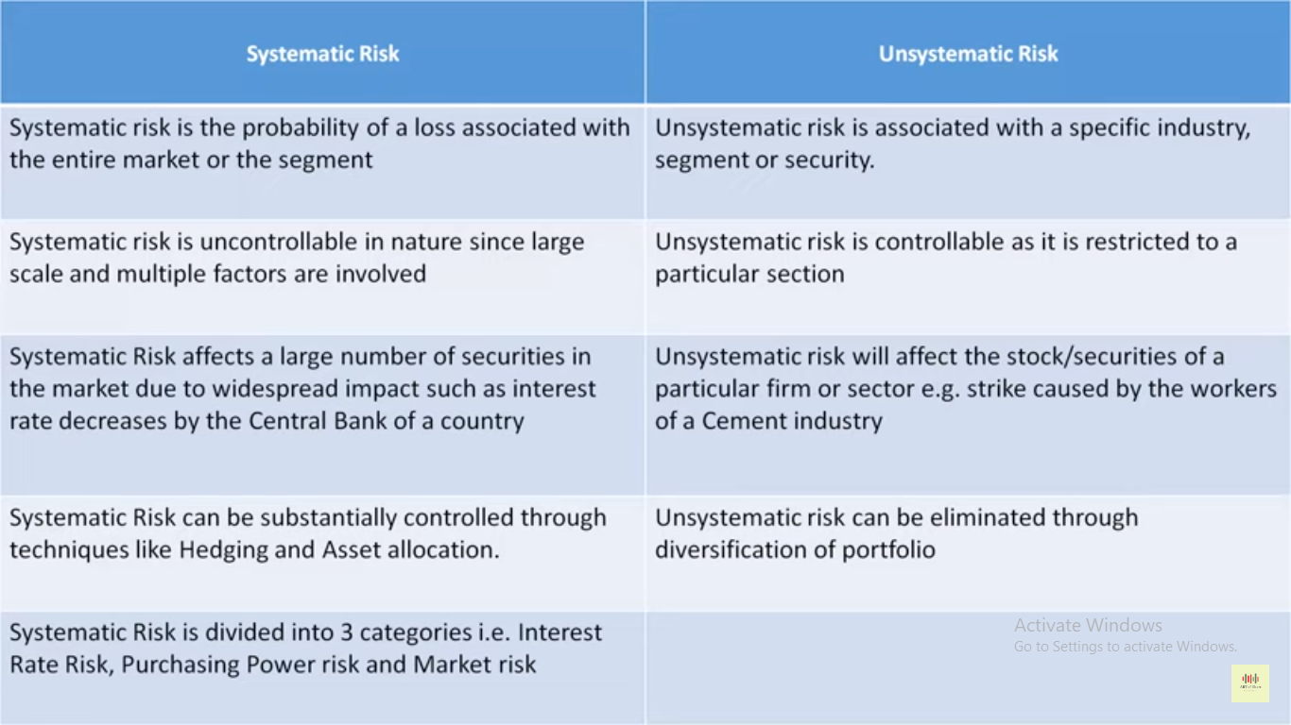

Slide 4
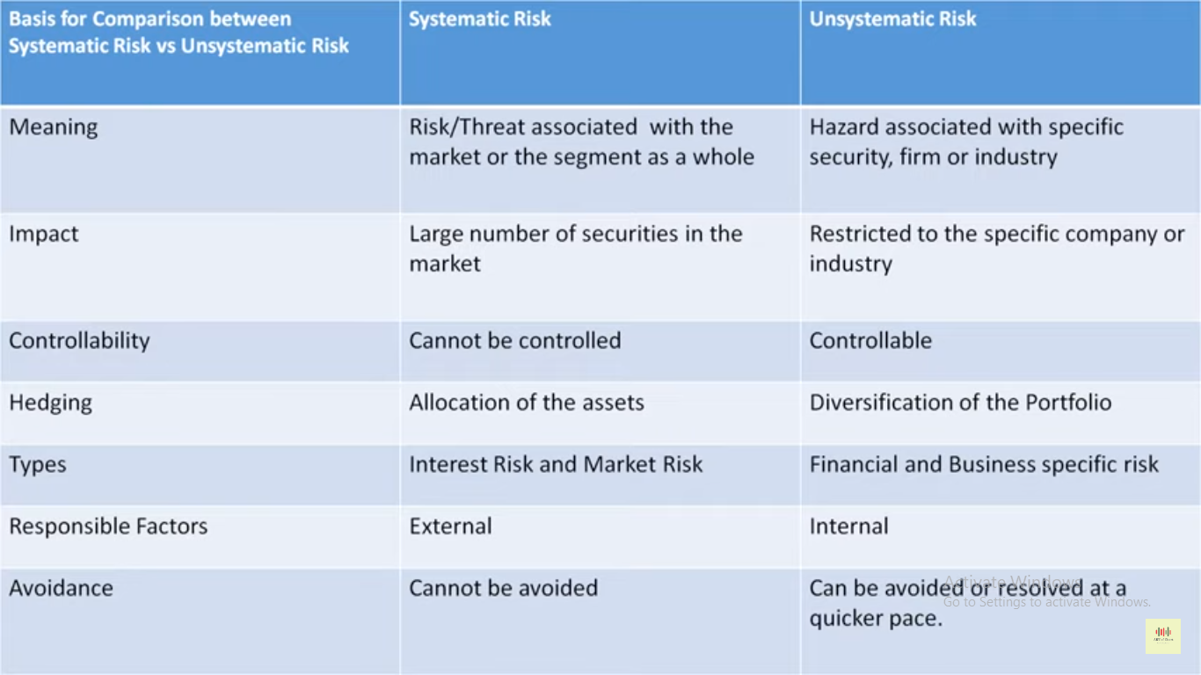

Slide 5
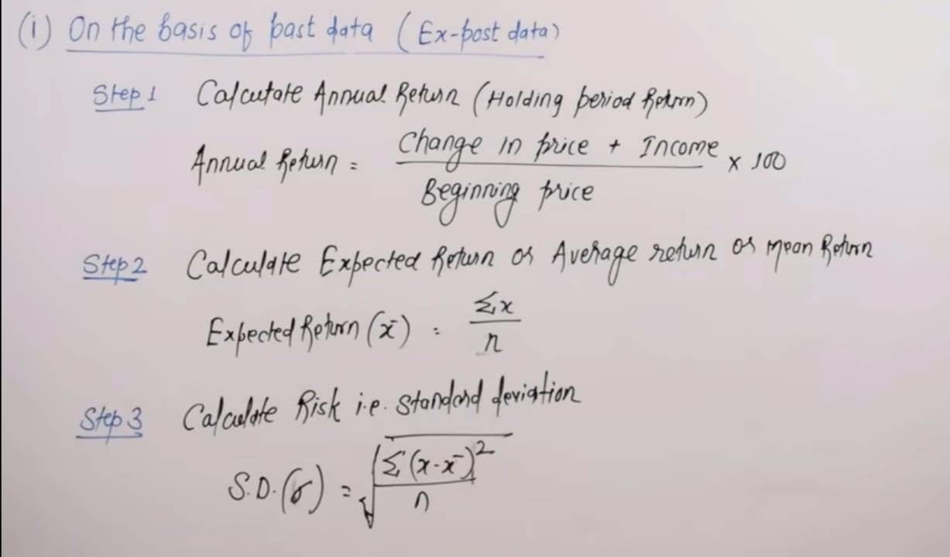
Expected Return

Slide 6
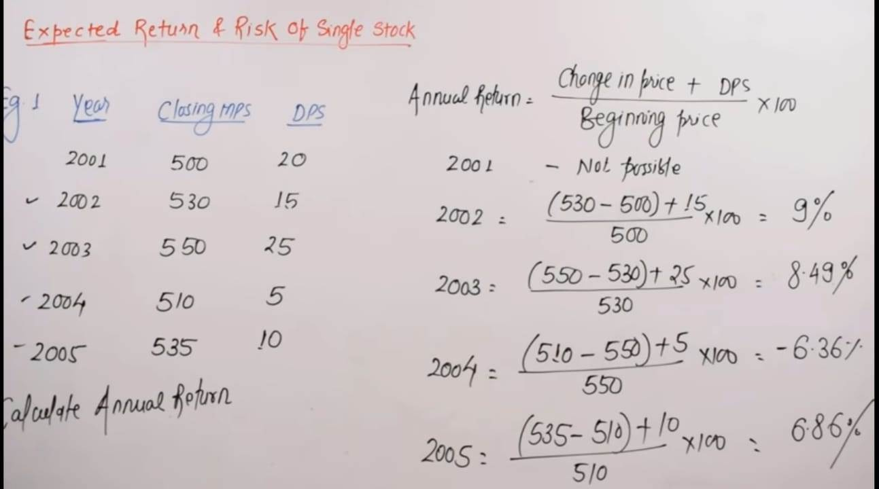
Expected Return of a Single Stock

Slide 7
Expected Return of a Single Stock

Slide 8
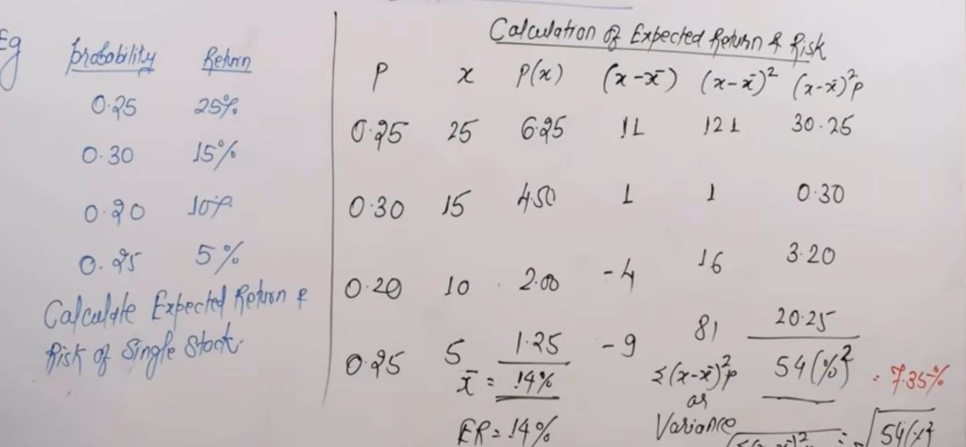
Expected Return By Probability

Slide 9

Historical Rates of Return
Holding Period Return

Slide 10
Historical Rates of Return
Historical Rates of Return

Slide 11
Investment returns
The rate of return on an investment can be calculated as follows:
(Amount received – Amount invested)
Return = ________________________
^{Amount invested}
For example, if $1,000 is invested and $1,100 is returned after one year, the rate of return for this investment is:
($1,100 - $1,000) / $1,000 = 10%.

Slide 12
What is investment risk?
Two types of investment risk
Stand-alone risk
Portfolio risk
Investment risk is related to the probability of earning a low or negative actual return.
The greater the chance of lower than expected or negative returns, the riskier the investment.

Slide 13
Probability distributions
A listing of all possible outcomes, and the probability of each occurrence.
Can be shown graphically.
Firm X
Firm Y
Rate of
Return (%)
-70
0
15
100
Expected Rate of Return

Slide 14

Selected Realized Returns, 1926 – 2001
Average Standard
Return Deviation
Small-company stocks 17.3% 33.2%
Large-company stocks 12.7 20.2
L-T corporate bonds 6.1 8.6
L-T government bonds 5.7 9.4
U.S. Treasury bills 3.9 3.2
Source: Based on Stocks, Bonds, Bills, and Inflation: (Valuation Edition) 2002 Yearbook (Chicago: Ibbotson Associates, 2002), 28.

Slide 15
Investment alternatives
Economy | Prob. | T-Bill | HT | Coll | USR | MP
Recession | 0.1 | 8.0% | -22.0% | 28.0% | 10.0% | -13.0%
Below avg | 0.2 | 8.0% | -2.0% | 14.7% | -10.0% | 1.0%
Average | 0.4 | 8.0% | 20.0% | 0.0% | 7.0% | 15.0%
Above avg | 0.2 | 8.0% | 35.0% | -10.0% | 45.0% | 29.0%
Boom | 0.1 | 8.0% | 50.0% | -20.0% | 30.0% | 43.0%

Slide 16
Why is the T-bill return independent of the economy? Do T-bills promise a completely risk-free return?
T-bills will return the promised 8%, regardless of the economy.
No, T-bills do not provide a risk-free return, as they are still exposed to inflation. Although, very little unexpected inflation is likely to occur over such a short period of time.
T-bills are also risky in terms of reinvestment rate risk.
T-bills are risk-free in the default sense of the word.

Slide 17
How do the returns of HT and Coll. behave in relation to the market?
HT – Moves with the economy, and has a positive correlation. This is typical.
Coll. – Is countercyclical with the economy, and has a negative correlation. This is unusual.

Slide 18
Return: Calculating the expected return for each alternative

Slide 19
Summary of expected returns for all alternatives
Exp return
HT 17.4%
Market 15.0%
USR 13.8%
T-bill 8.0%
Coll. 1.7%
HT has the highest expected return, and appears to be the best investment alternative, but is it really? Have we failed to account for risk?

Slide 20
Risk: Calculating the standard deviation for each alternative

Slide 21
Standard deviation calculation

Slide 22
Comparing standard deviations
Prob.
T - bill
USR
HT
0 8 13.8 17.4 Rate of Return (%)

Slide 23
Comments on standard deviation as a measure of risk
Standard deviation (σ_{i}) measures total, or stand-alone, risk.
The larger σ_{i} is, the lower the probability that actual returns will be closer to expected returns.
Larger σ_{i} is associated with a wider probability distribution of returns.
Difficult to compare standard deviations, because return has not been accounted for.

Slide 24
Comparing risk and return
Security | Expected return | Risk, σ
T-bills | 8.0% | 0.0%
HT | 17.4% | 20.0%
Coll* | 1.7% | 13.4%
USR* | 13.8% | 18.8%
Market | 15.0% | 15.3%
* Seem out of place.

Slide 25
Coefficient of Variation (CV)
A standardized measure of dispersion about the expected value, that shows the risk per unit of return.

Slide 26
Risk rankings, by coefficient of variation
CV
T-bill 0.000
HT 1.149
Coll. 7.882
USR 1.362
Market 1.020
Collections has the highest degree of risk per unit of return.
HT, despite having the highest standard deviation of returns, has a relatively average CV.

Slide 27
Illustrating the CV as a measure of relative risk
Prob.
A
B
0
Rate of Return (%)
σ_{A} = σ_{B} , but A is riskier because of a larger probability of losses. In other words, the same amount of risk (as measured by σ) for less returns.

Slide 28
Investor attitude towards risk
Risk aversion – assumes investors dislike risk and require higher rates of return to encourage them to hold riskier securities.
Risk premium – the difference between the return on a risky asset and less risky asset, which serves as compensation for investors to hold riskier securities.

Slide 29
Portfolio construction: Risk and return
Assume a two-stock portfolio is created with $50,000 invested in both HT and Collections.
Expected return of a portfolio is a weighted average of each of the component assets of the portfolio.
Standard deviation is a little more tricky and requires that a new probability distribution for the portfolio returns be devised.

Slide 30
Calculating portfolio expected return

Slide 31
An alternative method for determining portfolio expected return
Economy | Prob. | HT | Coll | Port.
Recession | 0.1 | -22.0% | 28.0% | 3.0%
Below avg | 0.2 | -2.0% | 14.7% | 6.4%
Average | 0.4 | 20.0% | 0.0% | 10.0%
Above avg | 0.2 | 35.0% | -10.0% | 12.5%
Boom | 0.1 | 50.0% | -20.0% | 15.0%

Slide 32
Calculating portfolio standard deviation and CV

Slide 33
Comments on portfolio risk measures
σ_{p} = 3.3% is much lower than the σ_{i} of either stock (σ_{HT} = 20.0%; σ_{Coll.} = 13.4%).
σ_{p} = 3.3% is lower than the weighted average of HT and Coll.’s σ (16.7%).
∴ Portfolio provides average return of component stocks, but lower than average risk.
Why? Negative correlation between stocks.

Slide 34
General comments about risk
Most stocks are positively correlated with the market (ρ_{k,m} ≈ 0.65).
σ ≈ 35% for an average stock.
Combining stocks in a portfolio generally lowers risk.

Slide 35
Returns distribution for two perfectly negatively correlated stocks (ρ = -1.0)
Stock W
Stock M
Portfolio WM
25
25
25
15
15
15
0
0
0
-10
-10
-10

Slide 36
Returns distribution for two perfectly positively correlated stocks (ρ = 1.0)
Stock M
Stock M’
Portfolio MM’
25
25
25
15
15
15
0
0
0
-10
-10
-10

Slide 37
Creating a portfolio: Beginning with one stock and adding randomly selected stocks to portfolio
σ_{p} decreases as stocks added, because they would not be perfectly correlated with the existing portfolio.
Expected return of the portfolio would remain relatively constant.
Eventually the diversification benefits of adding more stocks dissipates (after about 10 stocks), and for large stock portfolios, σ_{p} tends to converge to ≈ 20%.

Slide 38
Illustrating diversification effects of a stock portfolio
σ_{p} (%)
Company-Specific Risk
35
Stand-Alone Risk, σ_{p}
20
0
Market Risk
10 20 30 40 2,000+
# Stocks in Portfolio

Slide 39
Breaking down sources of risk
Stand-alone risk = Market risk + Firm-specific risk
Market risk – portion of a security’s stand-alone risk that cannot be eliminated through diversification. Measured by beta.
Firm-specific risk – portion of a security’s stand-alone risk that can be eliminated through proper diversification.

Slide 40
Failure to diversify
If an investor chooses to hold a one-stock portfolio (exposed to more risk than a diversified investor), would the investor be compensated for the risk they bear?
NO!
Stand-alone risk is not important to a well-diversified investor.
Rational, risk-averse investors are concerned with σ_{p}, which is based upon market risk.
There can be only one price (the market return) for a given security.
No compensation should be earned for holding unnecessary, diversifiable risk.

Slide 41
Capital Asset Pricing Model (CAPM)
Model based upon concept that a stock’s required rate of return is equal to the risk-free rate of return plus a risk premium that reflects the riskiness of the stock after diversification.
Primary conclusion: The relevant riskiness of a stock is its contribution to the riskiness of a well-diversified portfolio.

Slide 42
Beta
Measures a stock’s market risk, and shows a stock’s volatility relative to the market.
Indicates how risky a stock is if the stock is held in a well-diversified portfolio.

Slide 43
Calculating betas
Run a regression of past returns of a security against past returns on the market.
The slope of the regression line (sometimes called the security’s characteristic line) is defined as the beta coefficient for the security.

Slide 44
Illustrating the calculation of beta
_
k_{i}
.
20
15
10
5
.
Year k_{M} k_{i}
1 15% 18%
2 -5 -10
3 12 16
_
-5 0 5 10 15 20
k_{M}
Regression line:
k_{i} = -2.59 + 1.44 k_{M}
.
-5
-10
^
^

Slide 45
Comments on beta
If beta = 1.0, the security is just as risky as the average stock.
If beta > 1.0, the security is riskier than average.
If beta < 1.0, the security is less risky than average.
Most stocks have betas in the range of 0.5 to 1.5.

Slide 46
Can the beta of a security be negative?
Yes, if the correlation between Stock i and the market is negative (i.e., ρ_{i,m} < 0).
If the correlation is negative, the regression line would slope downward, and the beta would be negative.
However, a negative beta is highly unlikely.

Slide 47
Beta coefficients for HT, Coll, and T-Bills
_
40
20
k_{i}
HT: β = 1.30
T-bills: β = 0
_
-20 0 20 40
k_{M}
-20
Coll: β = -0.87

Slide 48
Comparing expected return and beta coefficients
Security Exp. Ret. Beta
HT 17.4% 1.30
Market 15.0 1.00
USR 13.8 0.89
T-Bills 8.0 0.00
Coll. 1.7 -0.87
Riskier securities have higher returns, so the rank order is OK.

Slide 49
The Security Market Line (SML): Calculating required rates of return
SML: k_{i} = k_{RF} + (k_{M} – k_{RF}) β_{i}
Assume k_{RF} = 8% and k_{M} = 15%.
The market (or equity) risk premium is RP_{M} = k_{M} – k_{RF} = 15% – 8% = 7%.

Slide 50
What is the market risk premium?
Additional return over the risk-free rate needed to compensate investors for assuming an average amount of risk.
Its size depends on the perceived risk of the stock market and investors’ degree of risk aversion.
Varies from year to year, but most estimates suggest that it ranges between 4% and 8% per year.

Slide 51
Calculating required rates of return
k_{HT} = 8.0% + (15.0% - 8.0%)(1.30)
= 8.0% + (7.0%)(1.30)
= 8.0% + 9.1% = 17.10%
k_{M} = 8.0% + (7.0%)(1.00) = 15.00%
k_{USR} = 8.0% + (7.0%)(0.89) = 14.23%
k_{T-bill} = 8.0% + (7.0%)(0.00) = 8.00%
k_{Coll} = 8.0% + (7.0%)(-0.87) = 1.91%

Slide 52
Expected vs. Required returns

Slide 53
Illustrating the Security Market Line
SML: k_{i} = 8% + (15% – 8%) β_{i}
k_{i} (%)
SML
.
HT
.
.
k_{M} = 15
k_{RF} = 8
.
USR
.
T-bills
Risk, β_{i}
-1 0 1 2
Coll.

Slide 54
An example: Equally-weighted two-stock portfolio
Create a portfolio with 50% invested in HT and 50% invested in Collections.
The beta of a portfolio is the weighted average of each of the stock’s betas.
β_{P} = w_{HT} β_{HT} + w_{Coll} β_{Coll}
β_{P} = 0.5 (1.30) + 0.5 (-0.87)
β_{P} = 0.215

Slide 55
Calculating portfolio required returns
The required return of a portfolio is the weighted average of each of the stock’s required returns.
k_{P} = w_{HT} k_{HT} + w_{Coll} k_{Coll}
k_{P} = 0.5 (17.1%) + 0.5 (1.9%)
k_{P} = 9.5%
Or, using the portfolio’s beta, CAPM can be used to solve for expected return.
k_{P} = k_{RF} + (k_{M} – k_{RF}) β_{P}
k_{P} = 8.0% + (15.0% – 8.0%) (0.215)
k_{P} = 9.5%

Slide 56
Factors that change the SML
What if investors raise inflation expectations by 3%, what would happen to the SML?
k_{i} (%)
SML₂
Δ I = 3%
18
15
11
8
SML₁
Risk, β_{i}
0 0.5 1.0 1.5

Slide 57
Factors that change the SML
What if investors’ risk aversion increased, causing the market risk premium to increase by 3%, what would happen to the SML?
k_{i} (%)
SML₂
Δ RP_{M} = 3%
18
15
11
8
SML₁
Risk, β_{i}
0 0.5 1.0 1.5

Slide 58
Verifying the CAPM empirically
The CAPM has not been verified completely.
Statistical tests have problems that make verification almost impossible.
Some argue that there are additional risk factors, other than the market risk premium, that must be considered.

Slide 59
More thoughts on the CAPM
Investors seem to be concerned with both market risk and total risk. Therefore, the SML may not produce a correct estimate of k_{i}.
k_{i} = k_{RF} + (k_{M} – k_{RF}) β_{i} + ???
CAPM/SML concepts are based upon expectations, but betas are calculated using historical data. A company’s historical data may not reflect investors’ expectations about future riskiness.

